Slide 1
Barone2
Spring Design Progress Review 1
Dylan Harootunian
Chin Ming Ryan Wong
Leonid Shuster
Jeremy Germenis
George Hernandez
Isaac Szu

Slide 2
Project Progression is behind in two areas
Mechanical Design - CAD design completed, all parts have been finalized, and fabrication has been started on the envelope. On Track
Systems Programming - Servo and motor control has been implemented in software, and remote control implementation was due by 4/9 but is expected by 4/19. Behind 1.5 weeks
PCB Design - PCB has been ordered and received but needs to be tested with components. Tanner pointed out a potential problem with power use on the board, which need to be addressed. On Track
Controls Design - Controls design has been delayed on the autonomous control system, and the closed loop remote control will be completed first instead for testing purposes. Behind 1 week
Drone Simulation - All major forces, remote control, and sensors have been implemented into the simulation . On track
Power Management - Most electrical components have been received and are being configured before integration. On Track
Conclusion: Design is behind in a few areas, but timeline is recoverable.
Notes:
Tanner pointed out 12V and 5V rail trace width need to be addressed

Slide 3
Major Milestones
Mechanical Design:
Fabricatable CAD Design: Complete
Finalize all parts and retailers: Complete
Order all parts needed for fabrication: Complete
Fabricate prototype Due 4/26: On Track
Envelope Fabrication in progress, with all parts mechanical parts received
Systems Programming:
Implement servo control in software: Complete
Implement motor control in software: Complete
Implement remote controller in software due 4/9: Late - expected 4/19
Instantaneous use of all 4 servos and motors wasn’t possible without the battery, which had not been ordered yet
Implement autonomous control in software due 4/26: Delayed
PCB Design:
Board wiring 3/19/21 Complete
Order PCB, power source, and remaining infrastructure 3/23/21 Complete
**MORE ON NEXT SLIDE**

Slide 4
Major Milestones (continued)
Controls Design:
Path Following and Terrain Tracking with Noisy Sensors: Late Due: 4/12 - Expected 4/19
General design completed, but gains are not satisfactorily tuned
Closed Loop Remote Control: Due 4/26 On Track
The closed loop is being prioritized now for testing purposes and should be completed early
Auxiliary Control Functions: Due 4/26 On Track
Large pitch/roll error handling is being designed currently, other functions not started
Drone Simulation:
Drag Forces Implementation: Complete
Sensors Simulation in V-rep: Complete
Noise added to sensors in V-rep: Due 4/19 On Track
Power Management:
Decide on Power Source 4/16/21: Complete
Test Motor Power Estimations in Real Time 4/26: On Track
Once Motors are running as intended, the total power used will be compared to estimates

Slide 5
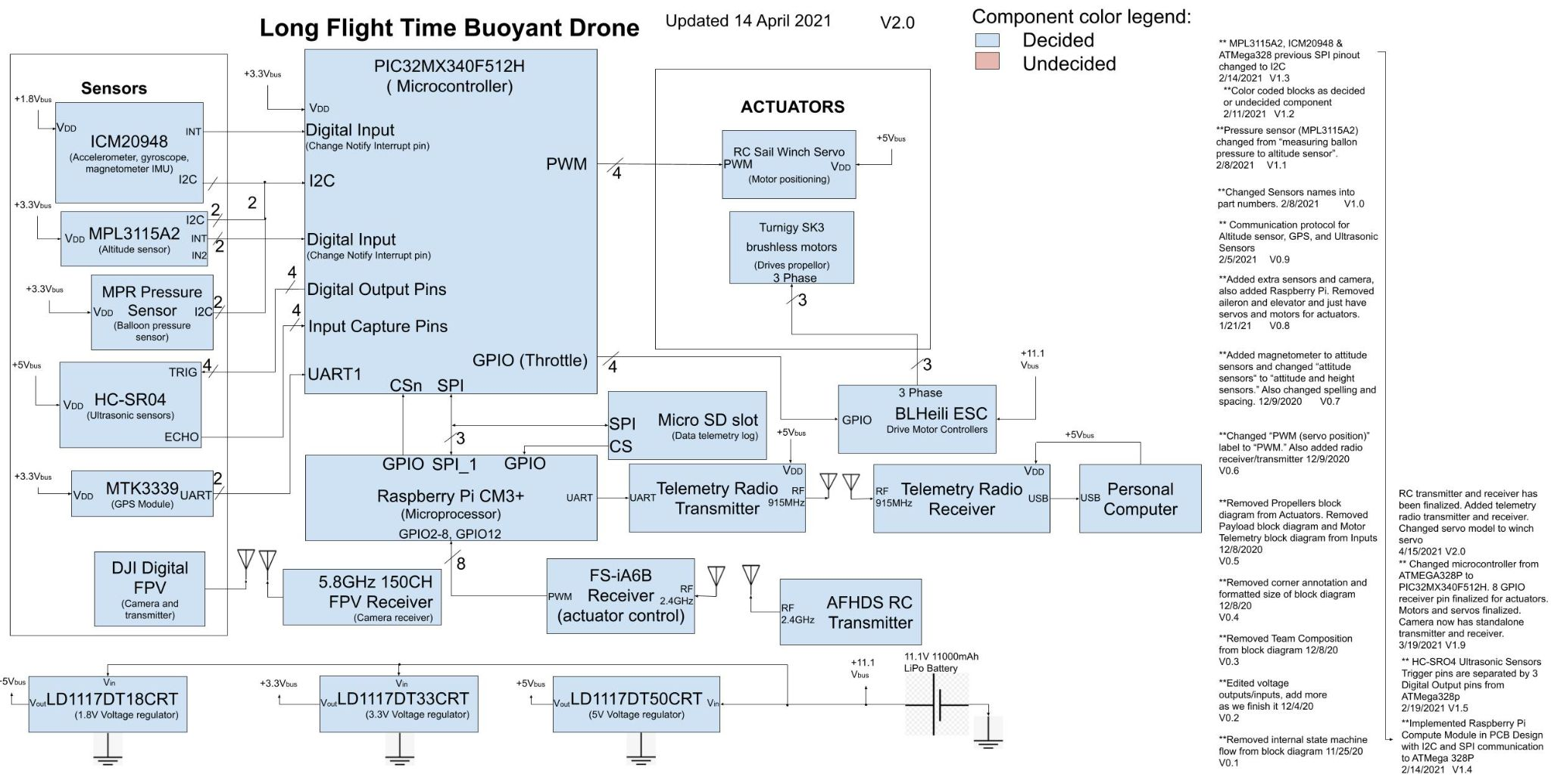
System Block Diagram Updated with Finalized Parts
Goal: Show finalized parts and additional parts added to system block diagram
Added telemetry radio RX & TX, communicates to microprocessor via UART and sends data to receiver via 915MHz radio. PC collects data via USB port of receiver.
Finalized RC receiver and transmitter, radio transmitter operates at 2.4GHz, receiver outputs 8 PWM signals to microprocessor for motors and servo control.
Conclusion: Telemetry Radios added and RC radios finalized in system block diagram.

Slide 6
Power Management Subteam is Progressing on Time, with all Current Milestones Completed
The following tasks will be presented in detail as forthcoming slides:
Milestone: Decide on Power Source: Complete
Decide areas where switching regulators can replace linear ones: Complete
Other Tasks:
Determine method for a low power warning with RC controller: Complete
Find way to calculate flight time in between min/max flight times: Complete
Upcoming Milestones:
Test Motor Power Estimations in Real Time 4/26/21: Expected 4/26/21
Conclusion: Power Management milestone completion is on schedule with the power source finalized. Future milestones depend on testing of the fabricated product and its performance

Slide 7
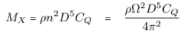
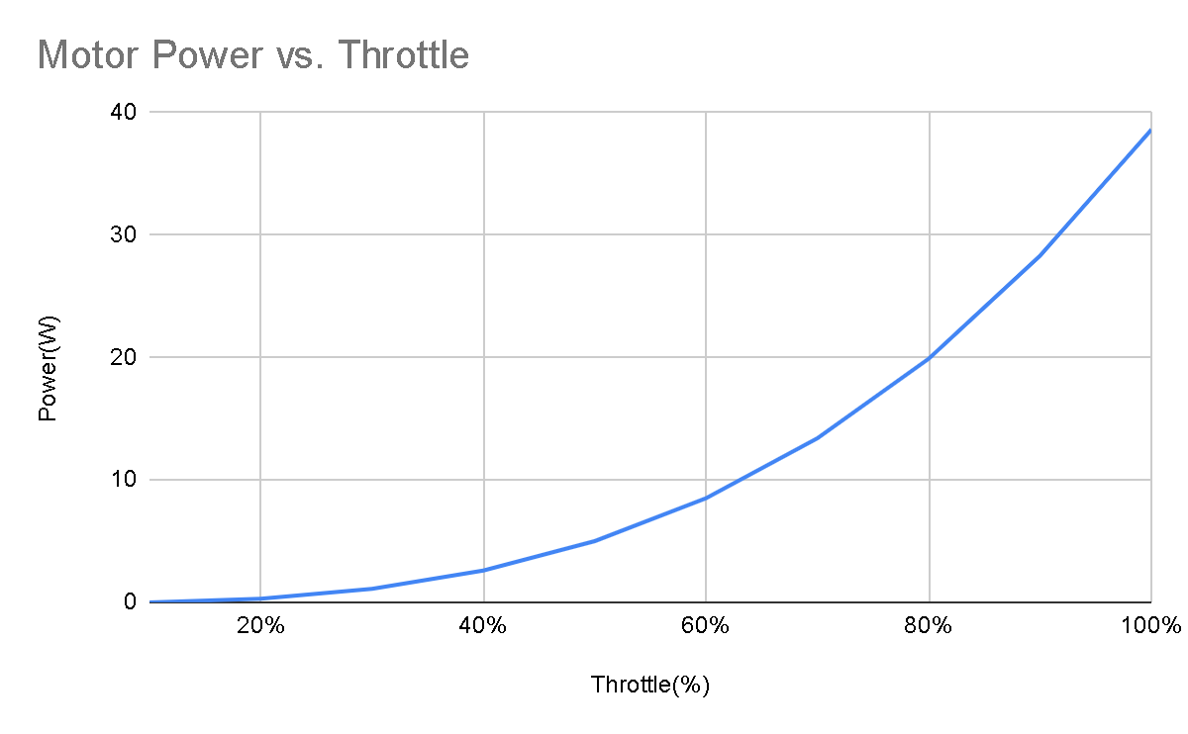
Total Power Usage is Estimated within the Min/Max Time Boundaries through Integrating Motor and Servo Usage
Complete
Requirement: System must remain in flight for at least 30 minutes
Constant Power Drain of 8.9W from sensors, controllers, and transmitters/receivers
Each Servo requires 1.75W when working and .6W when idle
Each Motor has power requirements based on throttle used, seen in the following chart:
Conclusion: Power use is calculated from the Watts needed integrated over the time in hours the servos and percentages of throttle are used for the motors to get the Watt-Hours(Wh) needed for a flight
More shown on next slide
Multiply Torque by Angular Velocity to get:
100% throttle at ~38W, 2.5N thrust
~80% throttle needed to hover at ~20W, 1.25N thrust
Beard, Randal W., and Timothy W. McLain. Small unmanned aircraft: Theory and practice. Princeton university press, 2012

Slide 8
Final Power Budget Analysis shows our Battery Fulfills our Flight Time System Technical Requirement
Complete
Requirement: System must maintain flight for at least 30 minutes and may
Fly for an Hour
Estimates from power budget V4.1
Total Flight Time(Hours) | Percentage of Time Motors at Full Thrust(Rest of the time, motors are at hovering throttle, or 80%) | Percentage of Time Servos are Turning | Total Energy Needed(Wh) Compared to 102Wh Safe Battery Discharge Capacity | Comments
.53 | 100% | 100% | 100 | Minimum flight time of 32 minutes at highest performance
1.01 | 0% | 0% | 101 | Max flight time of just over 1 hr while hovering in place
Total energy needed for a flight gained from power requirement estimations of each component
Conclusion: System is within its technical requirements of flight time in the current parts configuration, and the battery selected cannot be any smaller to satisfy our requirement
Notes:
Find representative curves. For depth of battery discharge.

Slide 9
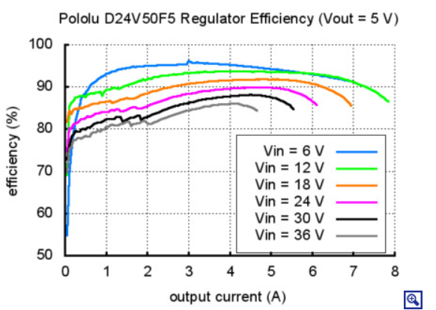
Max Flight Time of One Hour was Achieved by using a 5V Switching Regulator for Servos
Complete
Requirement: System should be able to reach a 1 hour flight time
With Linear Regulator:
11.1V Battery Voltage -> 5V Servo Voltage w/ max current of 1400mA
Dissipated 8.54W max, giving a Max flight time of 56 minutes
With Switching Regulator IC Chip:
85% min efficiency with 1400mA of load current*
At 5V, max of 1.24W is dissipated instead, decreased by 85.5%
Max flight time is increased to 60.5 minutes under
minimum performance
Switching regulators commonly have more noise on their output voltage, which is not ideal for powering the sensors
*Pololu 5V, 5A Step-Down voltage REGULATOR D24V50F5. (n.d.). Retrieved April 08, 2021, from https://www.pololu.com/product/2851
Conclusion: Use of a switching regulator increases flight time from 56 to 60.5 minutes, due to reduction in heat dissipation, while keeping other parts the same
Notes:
Find specifics of noise specs

Slide 10
Low Battery Voltage Detected by using a Step-Down Resistor with the RC Receiver
Complete
Requirement: System should give a low-power warning before battery threshold(9.6V) is reached
Max Battery Voltage of 12.6V converted to max receiver voltage of 6.5V, given a typical current of 9mA requires a minimum resistor of 678 ohms
This will display 100% Battery capacity
Minimum Battery Voltage of 9.6V converted to minimum receiver voltage of 4V to get a low-power warning requires minimum of 677 ohms,
This will display 0% battery capacity
Conclusion: By using a step-down resistor of 680 ohms, we are able to utilize the low-power warning function of our RC controller by adjusting the battery voltage and giving a warning when the adjusted battery voltage reaches the safe minimum. The user or autonomous controls should begin landing before reaching 5% of the safe battery discharge capacity to allow sufficient time to land.
Notes:
Have block diagram showing this, with voltage divider and battery connected to receiver

Slide 11
PCB Design Subteam is Progressing on Time with All Milestones Completed
Progress in PCB was made and broken down into slides covering:
Milestone:
Board wiring 3/19/21 Complete
Order PCB, power source, and remaining infrastructure 3/23/21 Complete
Task:
Calculate minimum trace width for: 12V rail, 3.3V rail, and 5V rail
Temporary fixes for V1.9 Board Upcoming Task Expected by 4/22/2021
Propose V2.0 PCB design that addresses problems from V1.9 Upcoming Task Expected by 4/22/2021
Conclusion: Board wiring is complete and trace widths in wiring design are within tolerances. All components are ordered and is currently being shipped to Leonid Shuster.

Slide 12
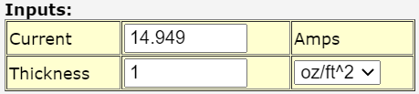
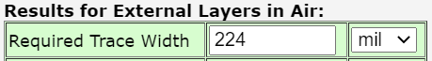
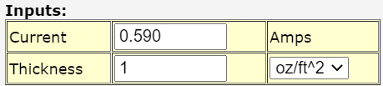
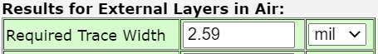
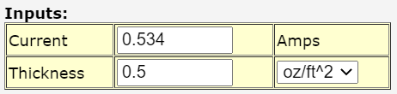
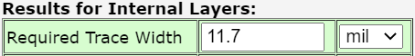
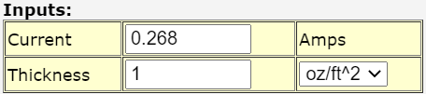

PCB Trace Width calculated for 11.1V, 5V, 3.3V and 1.8 V rail
Complete
12V Rail @ 14.949A max current
Requirement: Trace width must be within tolerance of minimum required trace width for each voltage rail
Online PCB trace width calculator [1]
Recommended by board house
Negligible current carrying capacity difference [2]
Temperature input of traces
25°C ambient temperature
36.8°C temperature rise
Version 1.9 PCB trace width is 208 mils below required
Version 2.0 PCB will have 224 mils trace width connected to ESC pinout
5V Rail @ 0.590A max current
Trace width of 5V rail is within tolerance
3.3V Rail @ 0.534A max current
Trace width of 3.3V is within tolerance
1.8V Rail @ 0.268A max current
Conclusion: 12V rail trace width is not within tolerance in V1.9. V2.0 will increase width 224 mils.
Trace width of 1.8V is within tolerance
[1] https://www.4pcb.com/trace-width-calculator.html
[2] https://www.proto-electronics.com/blog/how-to-choose-your-pcb-finish
Notes:
Find out what equation is exactly

Slide 13
Temporary Fixes for V1.9 Board
Upcoming Task Expected by 4/22/2021
Requirement: V1.9 board must be able to operate using externally soldered wire for 12V rail.
Hand solder jumper wires from 12V battery to ESC
Plug in 12V battery into PCB 12V header without using ESC pinout
Avoids burning up 16 mil traces and overheating/ melting the board
All other electrical components soldered on the board or breakout boards can be connected and should work
Conclusion: Avoid connecting 12V rail to ESC pinout and V1.9 board should still work.

Slide 14
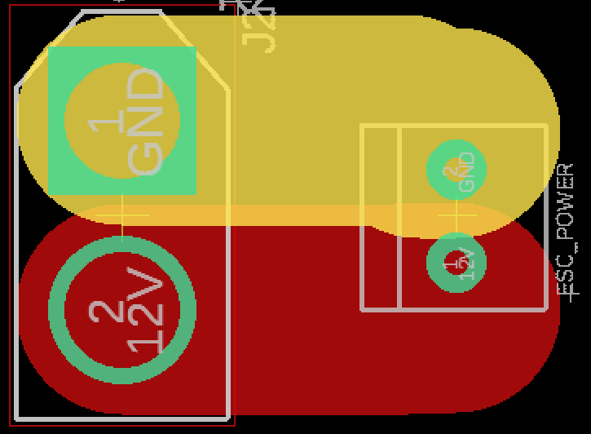
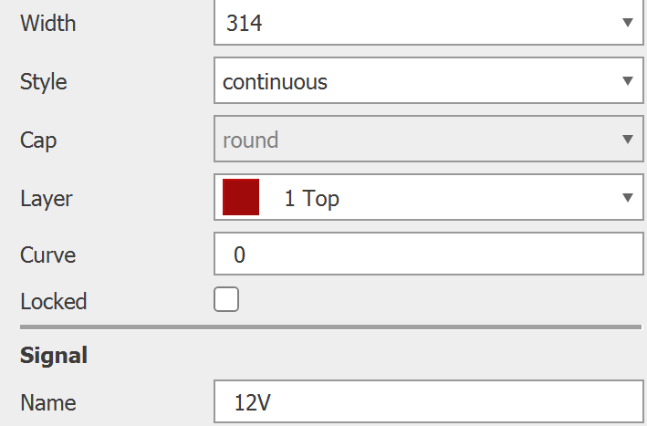
V2.0 PCB Proposed Fixes
Upcoming Task Expected by 4/22/2021
Requirement: Address trace width fixes for 11.1V rail, fix any hardware bugs from V1.9 board.
V2.0
mils
Increased trace width to 314 mils between 12V battery to ESC
Trace width setting of 12V rail in V2.0
Reduce trace length by placing battery pinout and voltage rails close together
Separate data bus from voltage rails to avoid EMI
Debug issues from V1.9 board
Conclusion: Next iteration of PCB design will address PCB trace width issue and any potential issue after V1.9 board is tested.
Notes:
Parallel top and bottom, to increase current density

Slide 15
Systems Programming is Behind Schedule
The following tasks will be presented in detail as forthcoming slides:
Milestones:
Implement servo control in software: Complete
Implement motor control in software: Complete
Implement remote controller in software due 4/9: Late - expected 4/19
Receiver has been connected to Raspberry Pi and verified to receive proper signals from remote controller
Instantaneous use of all 4 servos and motors wasn’t possible without the battery, which had not been ordered yet
Implement autonomous control in software due 4/26: Delayed
Conclusion: Servo and motor control has been completed, and will be implemented with remote controller usage by 4/19

Slide 16
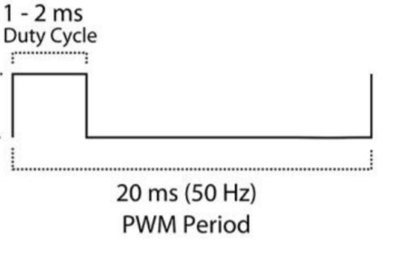
Servos were Configured with Timers and Interrupts
Complete
Requirement: Servos shall rotate each direction within 3 full turns
Procedure:
Generate 20 ms (50 Hz) Timer
Vary duty cycle (and thus servo position) by using second Timer to trigger servo signal high for certain period
1 ms - minimum servo position of 3T counter-clockwise
1.5 ms - middle servo position
2 ms - maximum servo position of 3T clockwise
**MORE ON NEXT SLIDE**
Servo timing diagram from Servo Motor SG90 datasheet

Slide 17
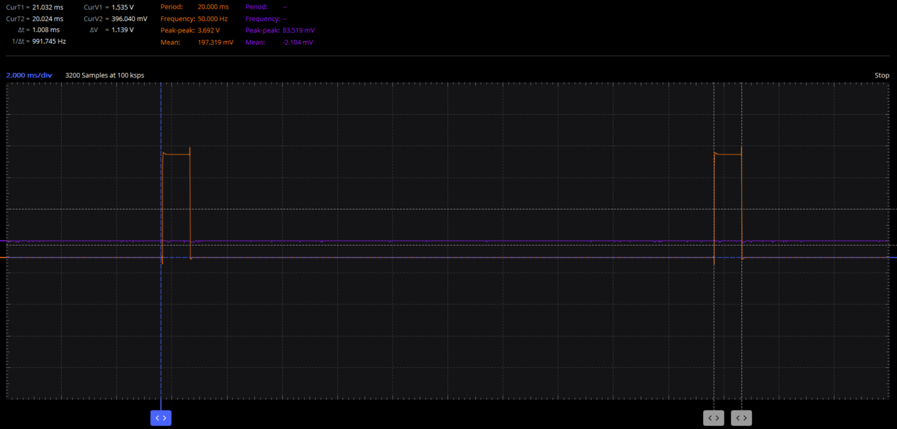

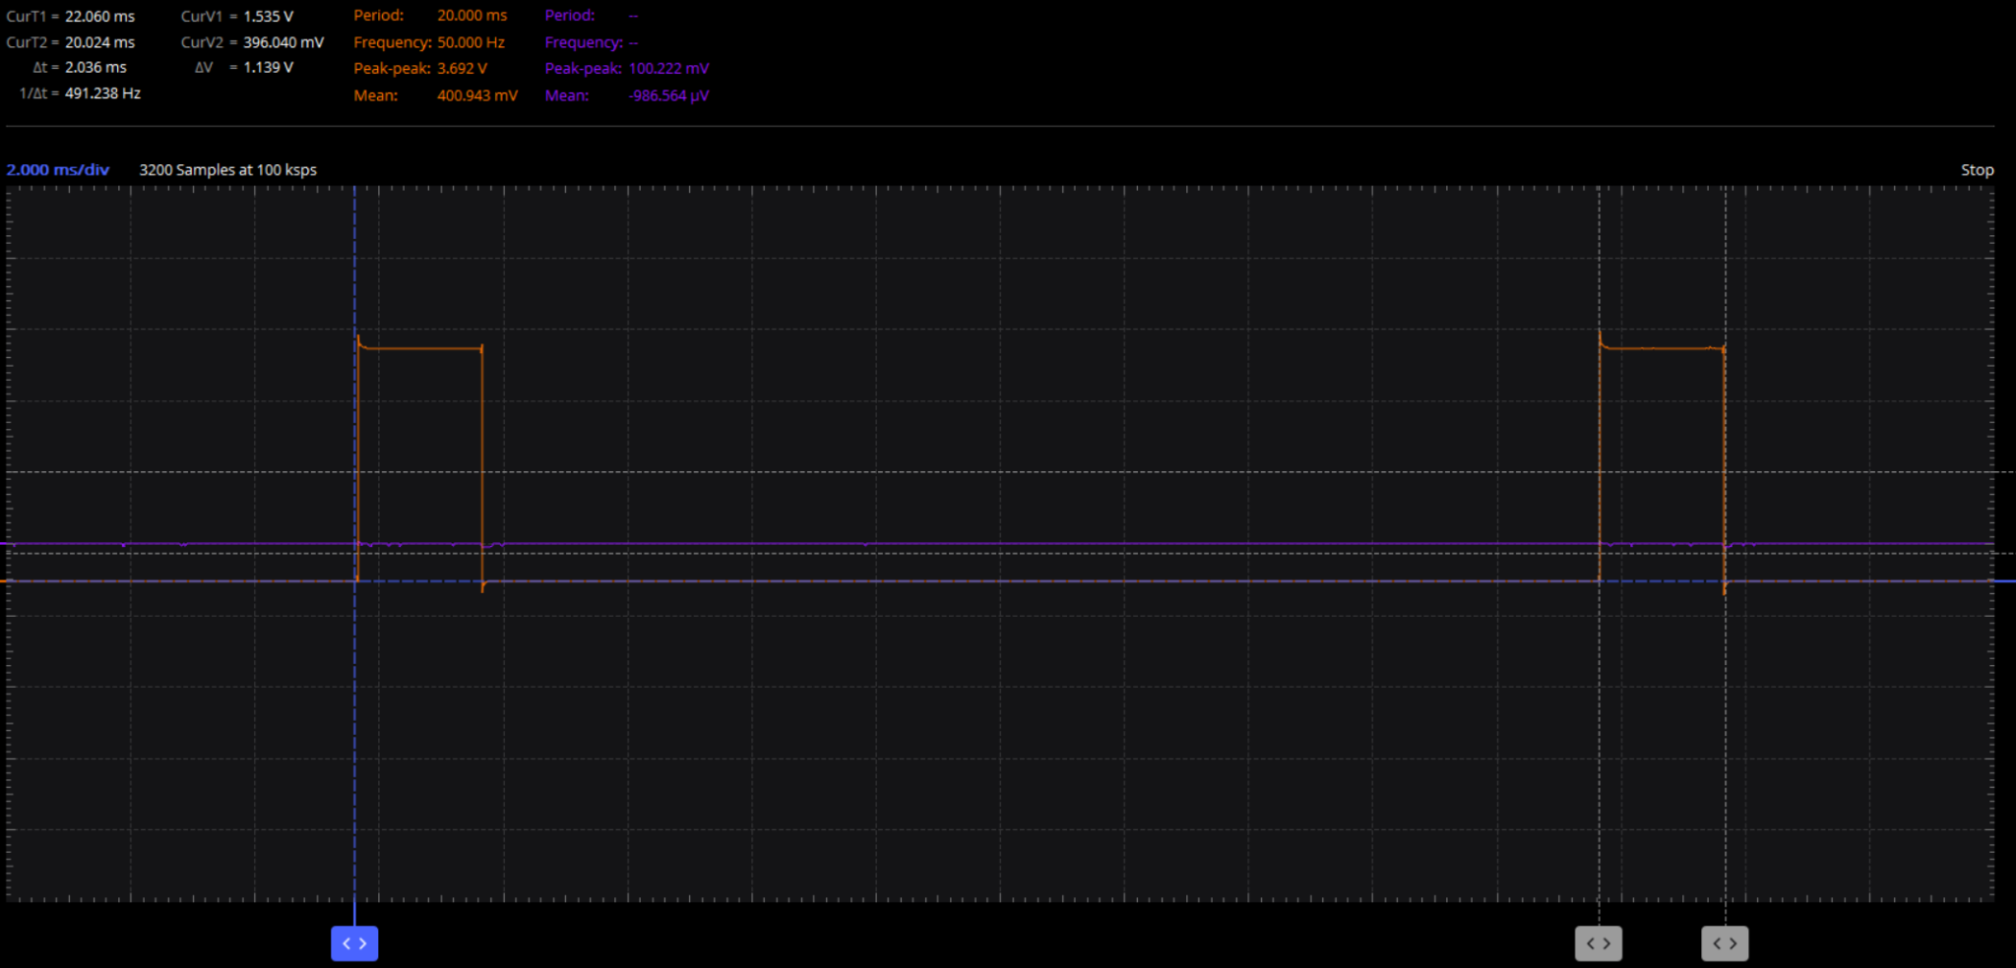
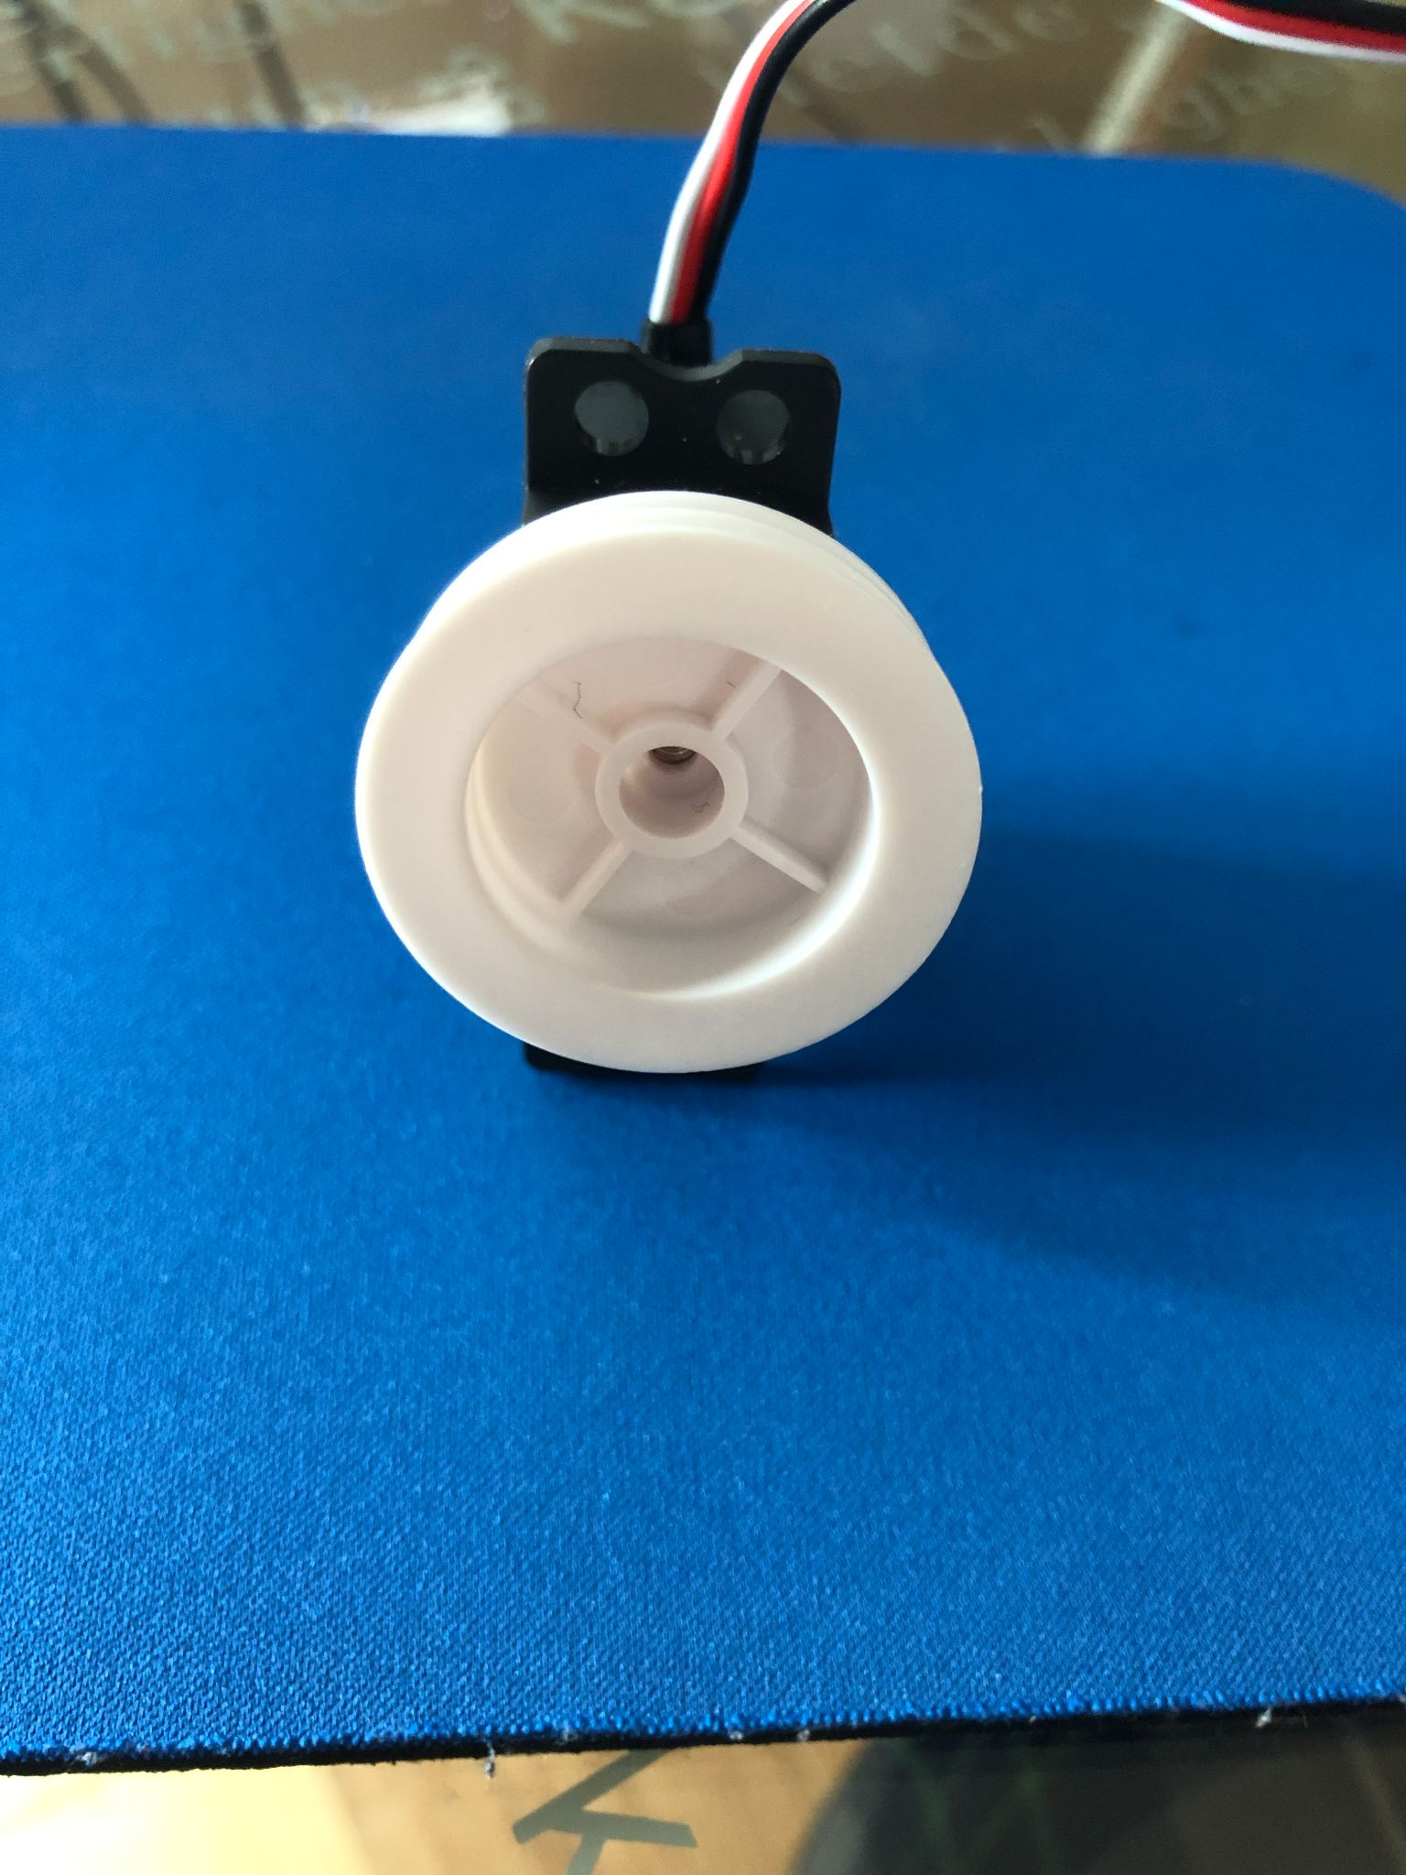
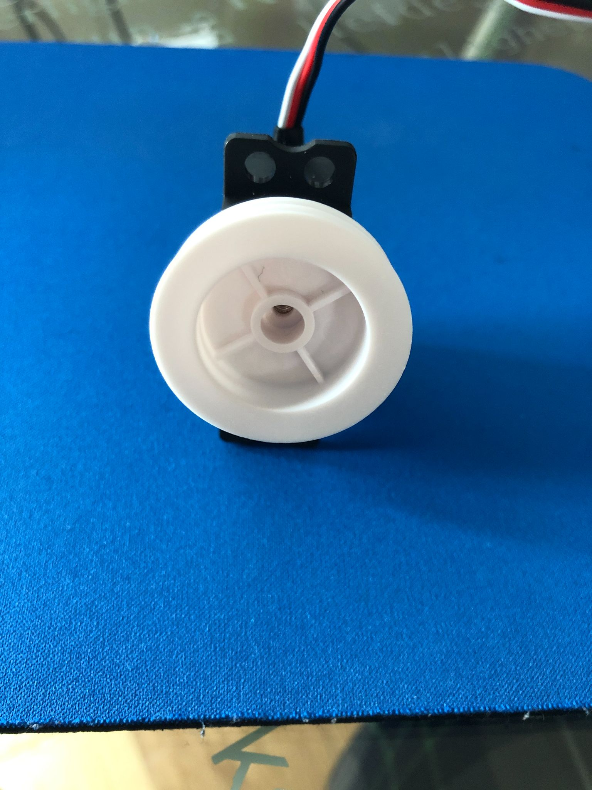
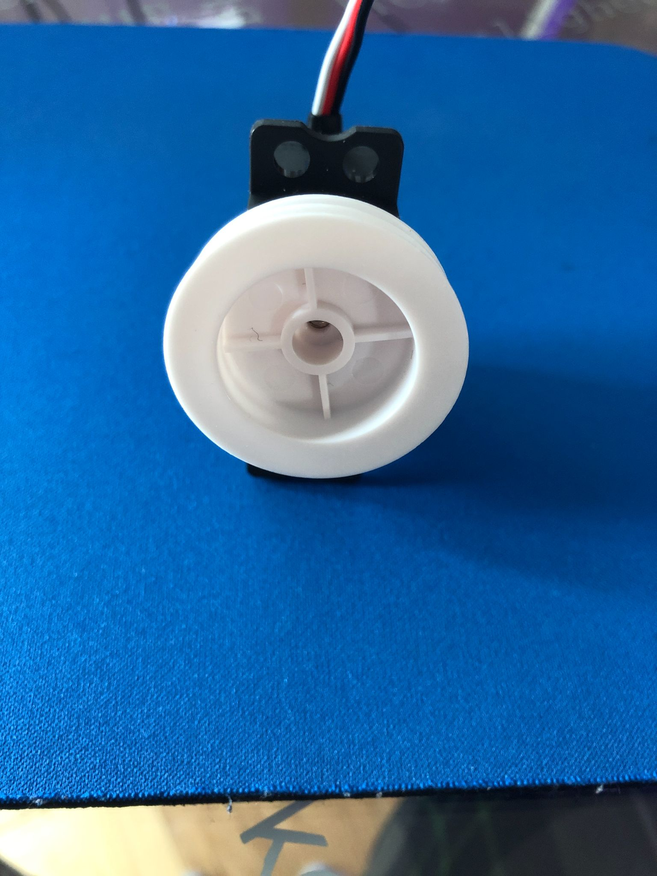
Servos were Configured with Timers and Interrupts (continued)
Complete
Conclusion: Servos are given proper signal, but duty cycles need more tuning as they do not achieve perfect 360° rotations as shown
1ms duty cycle, 3T counter-clockwise 1.5ms duty cycle, neutral 2ms duty cycle, 3T clockwise
20ms (50Hz)

Slide 18
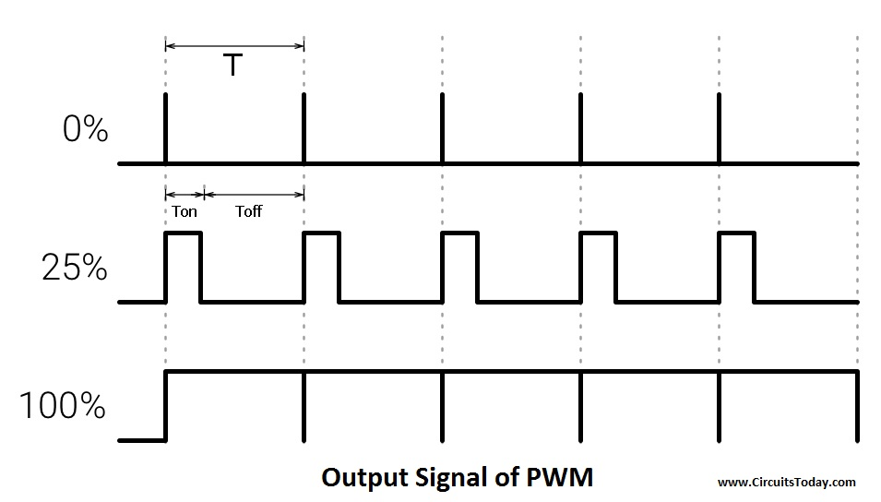
Motors were Configured with Timers and Output Captures
Complete
Requirement: Motors shall spin with controllable duty cycle within 0%-100%
Procedure:
Generate 10 kHz Timer
Vary duty cycle (and thus motor speed) by using Output Capture with PWM mode to trigger motor signal high for certain period
0% duty cycle - 0 motor voltage
50% duty cycle - 50% motor voltage
100% duty cycle - 100% motor voltage
**MORE ON NEXT SLIDE**
Motor timing diagram from CircuitsToday.com

Slide 19
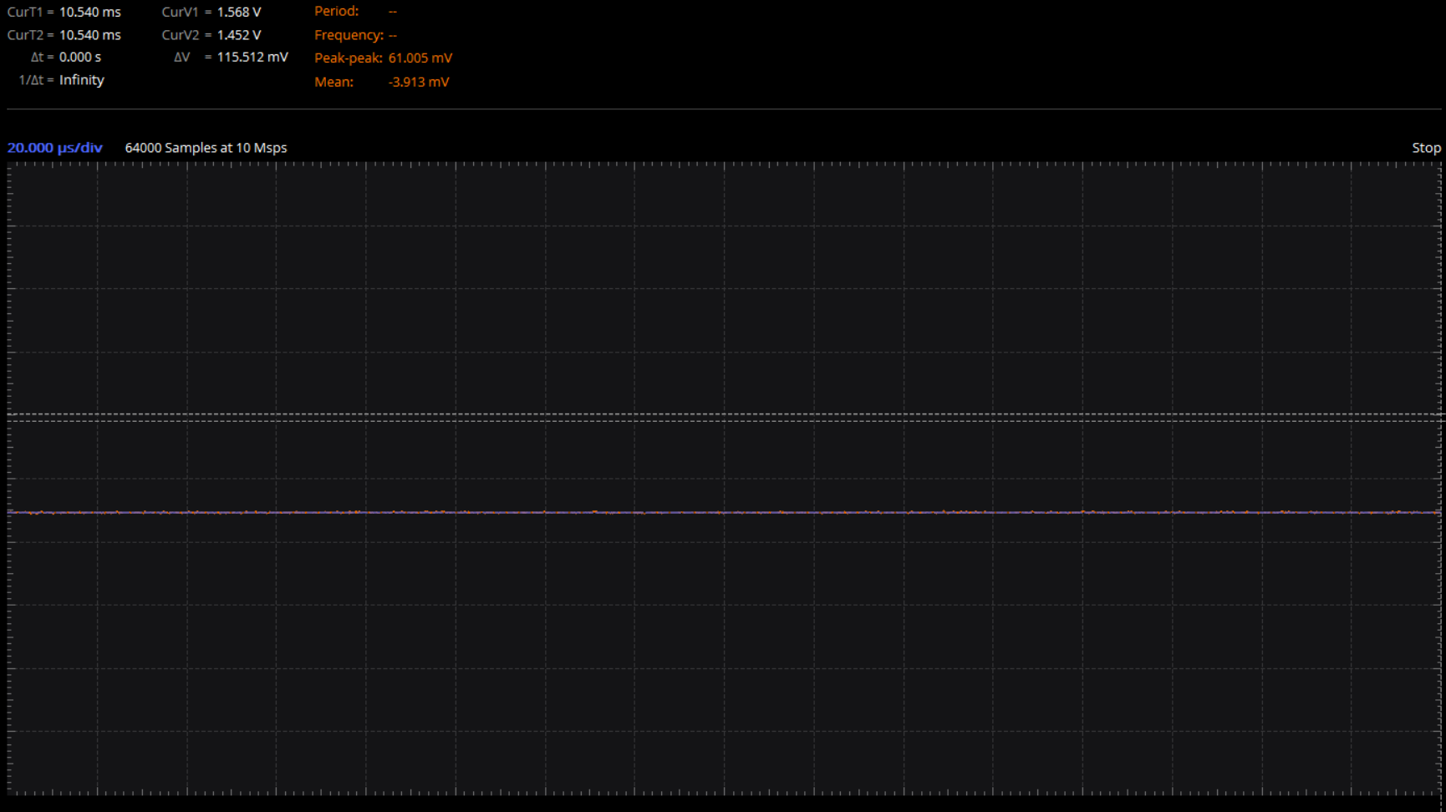
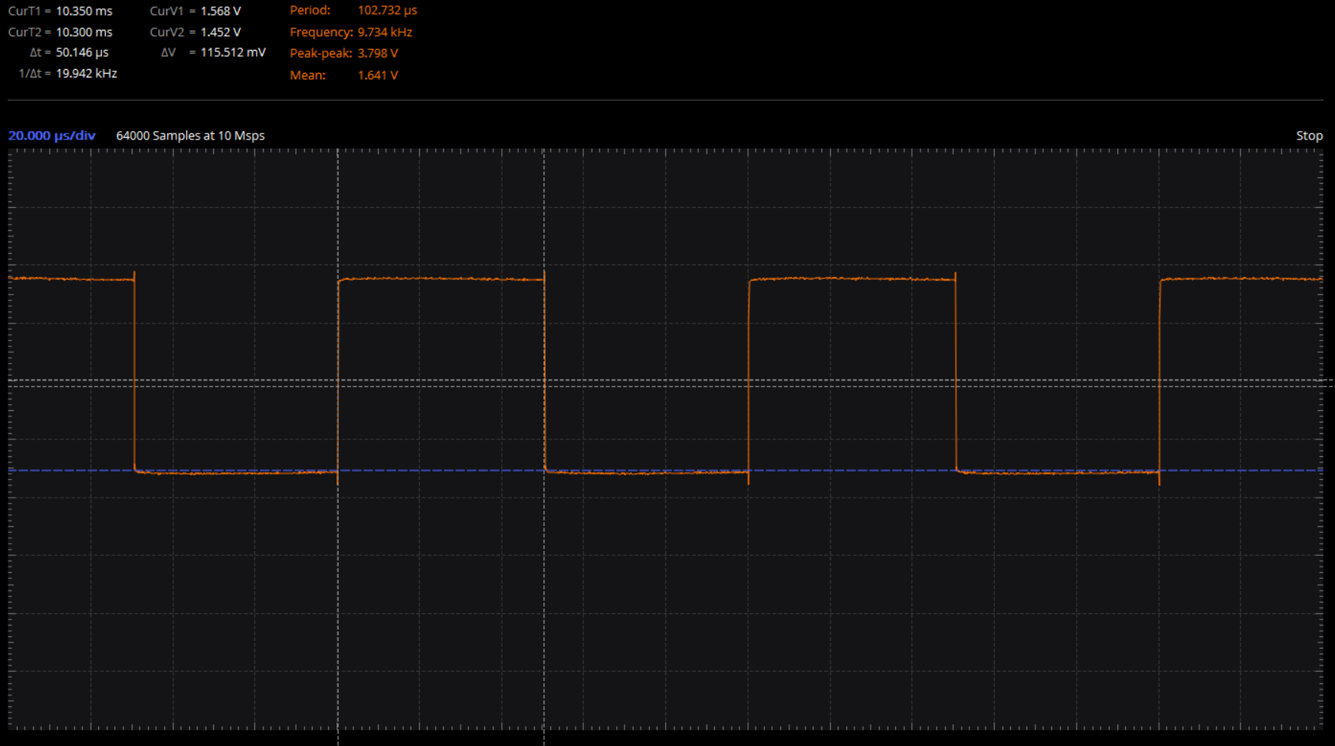
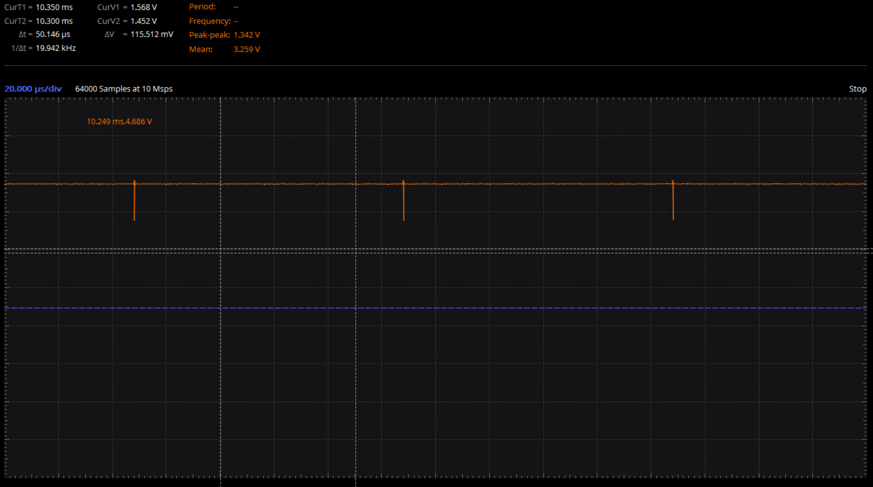
Motors were Configured with Timers and Output Captures (continued)
Complete
Conclusion: Motors are given proper signal, and will be tested all at the same time shortly with the battery
0% duty cycle 50% duty cycle 100% duty cycle
10kHz

Slide 20
Remote Controller Connected but Still Needs Servo/Motor Control Integrated
Late: Expected 4/19
Requirement: Remote Controller moves servos and motors according to controller throttle, yaw, pitch, roll, and button inputs
Progress:
Receiver has been connected to microprocessor and verified to receive proper signals from remote controller (throttle, yaw, pitch, roll, and various buttons)
Next step is to forward remote controller signals from Raspberry Pi to PIC32 to maneuver servos and motors
Conclusion: Remote Controller functionality has been verified, but still has yet to move any servos and motors

Slide 21
Mechanical Design Subteam is Progressing on Time with All Milestones Completed
The following tasks involving mechanical design progression will be presented in detail as forthcoming slides:
Milestone:
Fabricatable CAD Design: Complete
Finalize all parts and retailers: Complete
Order all parts needed for fabrication: Complete
Fabricate Prototype Due 4/26/21: On Track
Fabricate Envelope: In Progress
Print and attach 3D parts: Upcoming
Add and wire electronics: Upcoming
Conclusion: The design phase has concluded. The fabrication phase has started and the prototype is on track to being completed by 4/26. Testing at the flight room at 2300 Delaware to follow

Slide 22
New Winch Servos Analysed, Ordered, and Received
Complete
Requirement: Servo must be able to Turn multiple rotations and take positional data while providing the required torque.
New servos had to be chosen as originals did not take positional data
Analysis was done using Servo power to find angular acceleration using the same method as the original RedCon 360 Degree Digital Metal Gear HV Servo
It was found that the The RC Sail Winch Servo 25T should be able to provide the maximum worst case needed torque 0.2NM which is less then the 1.04NM stall torque
The same method used to analysis the RedCon 360 Degree Digital Metal Gear HV Servo was applied here, where ꞇ = lɑ , ɑ was found using power values, and l was found using solidworks analysis
The RC Sail Winch Servo 25T takes positional data and can make 5.5 full turns
Conclusion: The RC Sail Winch Servo 25T is capable of providing the required torque as well as taking positional data with multiple rotations

Slide 23
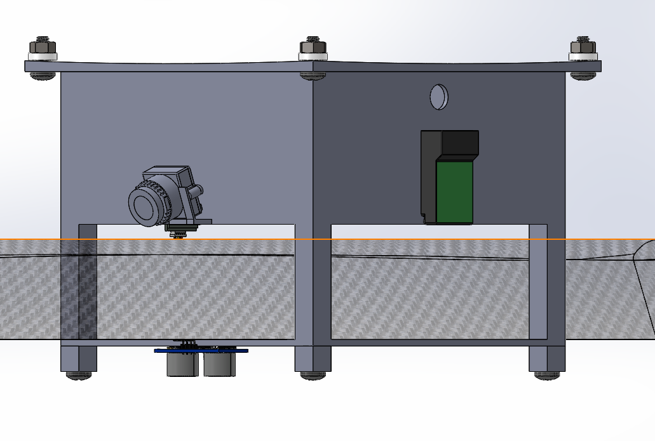
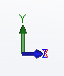
Payload Bay Added to CAD
Complete
V3.28
Requirement: Holding shall be able to contain the MagArrow (1000x150x50mm)
Landing area was dimensioned in order to fit the Mag Arrow senor which has a height and width dimensions of 50x150mm
6”
Ultrasonic sensor used for landing was, moved to bottom of the bay, in order to have clear line of sight down
58mm
50mm
153mm
150mm
Isometric Front, Right
Conclusion: by dimensioning the Payload Bay to 153x153x58mm, it shall be able to hold the MagArrow payload, while still keeping an overall height of <6” (size of 3D printer Bed)

Slide 24
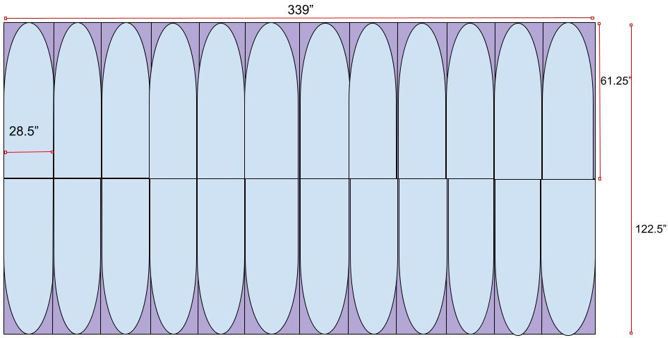
Gores Created to Make 3D Ellipsoid from 2D Nylon
Complete
Requirement: Gores shall be dimensioned to fabricate ellipsoidal envelope (108x108x40”)
The 12 gores will be fabricated in 24 parts, with each gore being cut in half in order to fit the size of the Nylon sheet.
Using Triangle Geometry and Law of sines the radius for the curves of each gore was found to be 138.25”
The width cannot be made any smaller as the volume would drop below 4m³, if larger the excess can be sewn taut.
138.25”
Conclusion: The envelope can be fabricated using 12 gores, each with a width of 1/12 the circumference of the envelope or 28.5” (28.26” + ¼” to account for stitching) , and a height of half the vertical circumference of 122.5”
Peterson, Dave. “Dave Peterson.” The Math Doctors, 17 Feb. 2020, www.themathdoctors.org/making-a-sphere-from-flat-material/.
Notes:
Add refresher slide maybe?

Slide 25
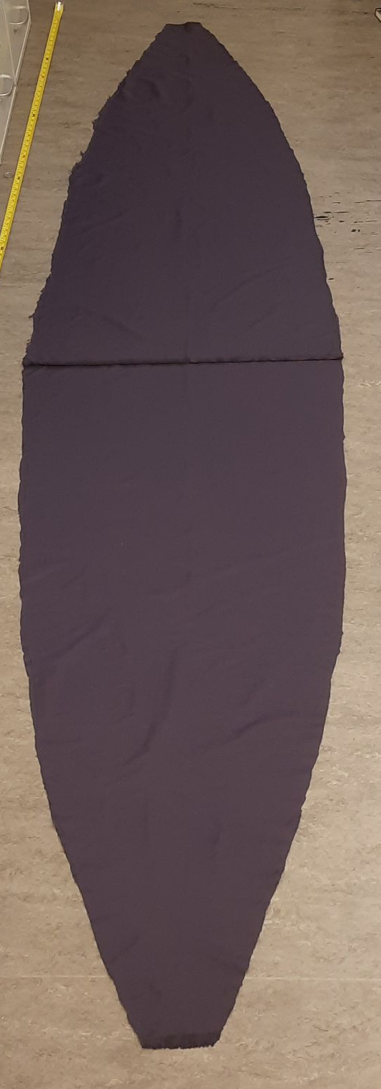
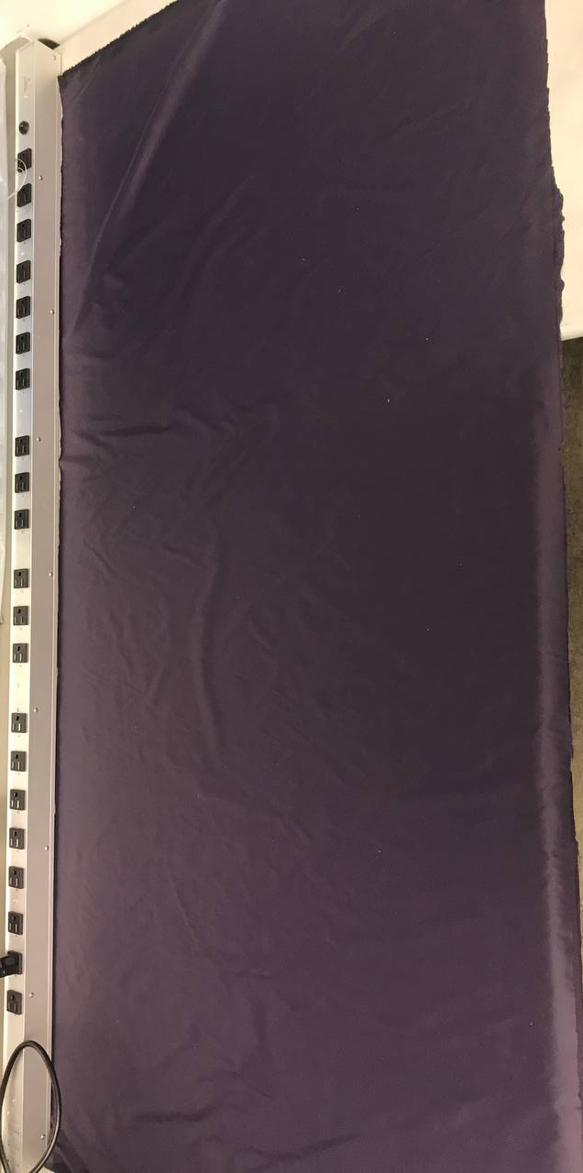
Gores Being Created Based on Dimensions
In Progress
Expected 4/18
Requirement: Envelope will contain 4 cubic meter lift bag while holding (108x108x40”) ellipsoid shape
24 sheets of 28.5x60 where cut, using a meter stick to measure and as a straight edge
Curves with a 138.25” radius where cut from each sheet
Top and bottom of gore are trimmed 1.25” for access.
28.5”
28.5”
120”
60”
An extra ¼” was added to the gore width to account for stitching
Conclusion: The fabrication process of the gores is underway. With the fabrication of the Envelopes expected to be completed by the 4/18. I think the envelope will come out shaped correctly if all the gores continue to come out well.
Notes:
Top and bottom of gore are trimmed for access

Slide 26
Control Design Subteam is Behind on Autonomous Design
Progress has been broken down of the forthcoming slides including:
Milestones:
Full State Feedback for Autonomous Control: Late: Due 4/12 Expected 4/26
Closed Loop Remote Control Design: Due 4/26 In Progress Expected 4/19
Priority changed to complete Remote System first for testing
Auxiliary Functions: Due 4/26 On Time
Large pitch/roll angle correction: In Progress
Auto Takeoff/landing: Not Started
Tasks
Height Tracking Algorithm: In Progress
Conclusion: Currently about a week behind but can catch up by the 4/26 deadlines

Slide 27
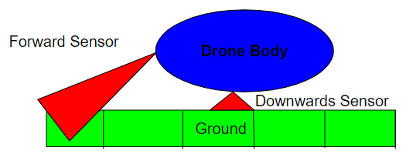
Proposal of Height Tracking Algorithm with Limited Field of View
In Progress
Requirement: Maintain a height of 1 ± 0.15 meters above the ground
Method:
Break up the area underneath the drone into different blocks
Store the max value of each block
Update block height using accelerometer data where ultrasonics don’t cover
Move the blocks as the drone moves
Conclusion: We would appreciate the teaching team’s input on the algorithm before programming
Figure: View of Ultrasonic Field of View and need to store height data. V1

Slide 28
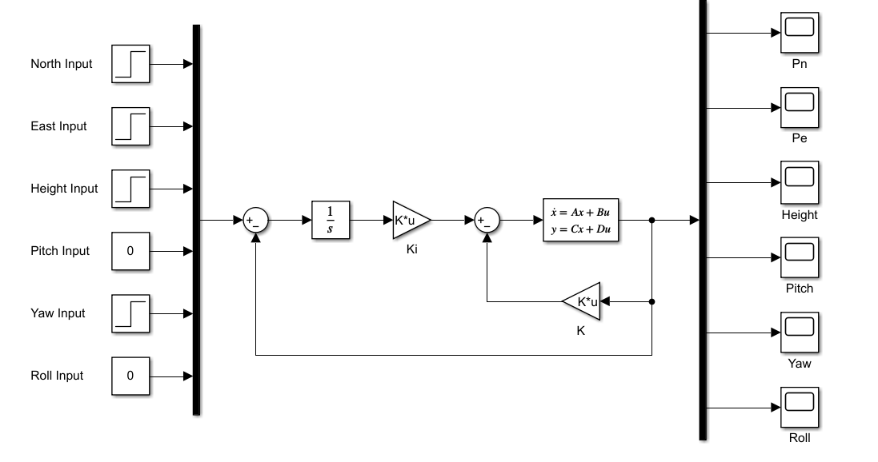
Full State Feedback for Autonomous Control Requires Tuning
Late. Expected 4/26
Requirement: Design a state space control system to maintain height, track a path, and remain stable.
General design seems like it’ll work, but it will take time to tune and we have decided Closed Loop RC should be completed first
Conclusion: The system needs tuning to meet requirements, but general design is complete and can begin programming in C
Figure. Full State Feedback Design for Autonomous Control

Slide 29
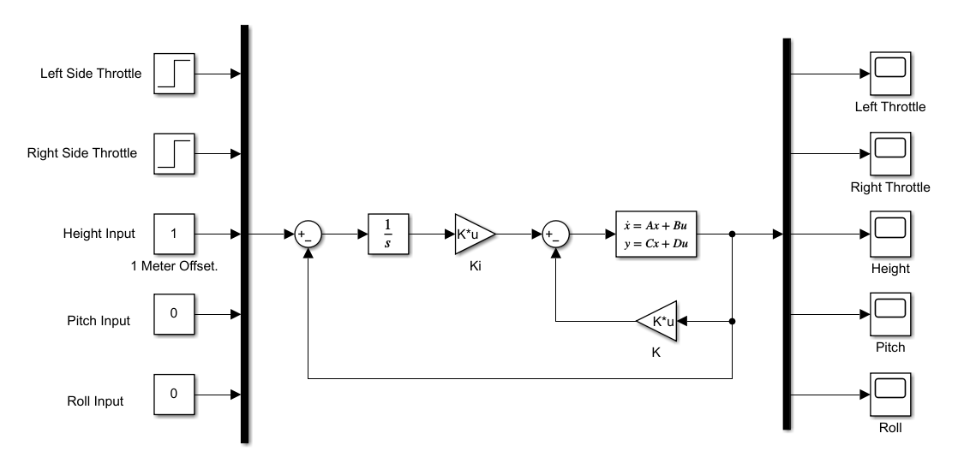
Closed Loop Remote Control Definition
In Progress. Expected 4/19
Task: Define a remote control plant to respond to forward, turning, and up/down commands from the user, while maintaining pitch and roll angles of zero.
States included in plant are left and right throttles, height, attitude and angular velocities. Pitch and roll inputs will always be zero, and we will be focusing on the left and right throttles and height.
Conclusion: Plant is being designed and ready to move forward with design.
Figure. Closed Loop Remote Control System design

Slide 30
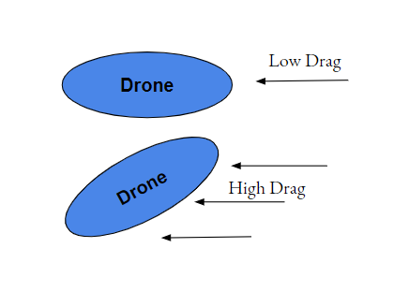
Large Pitch/Roll Angle Error will be Addressed with Simplified Control Response.
In Progress. Expected 4/26
Requirement: Create a control system to return the pitch and roll angles to normal operating range in the event of a Large Pitch/Roll Angle Error.
Large pitch and Roll angles can lead to a crash and must be handled immediately.
We plan to switch to a 2 DoF control response and set other functions on hold till stability is obtained.
Conclusion: The drone needs a simplified and aggressive response for returning the angles back to controllable angles. This is an error case that needs a specialized control response
Figure. A tilted ellipsoid will have much higher drag and become unstable

Slide 31
Drone Flight Simulation is progressing on time, with all milestones completed
The following tasks involving flight simulation progression will be presented in detail as forthcoming slides:
Milestones:
Drag Forces Implementation: Complete
Sensors Simulation in V-rep: Complete
Noise added to sensors in V-rep: Due 4/19 In Progress
Conclusion: Milestones currently due are completed and adding noisy sensors in the design is currently a work in progress to be done before closed loop control is completed

Slide 32

Drag Force Applied to the Center of Envelope
Complete
Requirement: Drag force is successfully simulated with and without wind on a static envelope, which is needed to more accurately represent real world conditions
Demonstration shows wind applied through spherical coordinates and drag on a static balloon.
Drag is applied without any wind, so the balloon moves slower simply from a simulated atmosphere.
Conclusion: Drag forces can be applied to the envelope with simple atmospheric conditions. Wind and drag forces use the drag equation but are different forces acting in different directions.

Slide 33
Drag Force Successfully Simulated on a Moving Drone
Complete
Requirement: Drag force is successfully simulated on a moving drone to simulate closer to real life conditions.
An example of wind being applied to a moving drone. The drone can fly 5 mph in a 15 mph headwind meeting our requirements.
Just 5 mph vertical airspeed can adversely affect the balloon as shown when the balloon stops rising at maximum propeller speeds.
Conclusion: The addition of drag in the simulation gives confirmation that the balloon is capable of safe navigation in varying environmental conditions.
Notes:
The simulation shows that the drone has a much greater difficulty flying in wind that moves directly up or down, which can be avoided when flying at low altitudes. Instability on the balloon can be corrected by autonomous, closed-loop piloting, but the force applied by drag is currently working as shown. 3.5m/s = 7.82mph

Slide 34
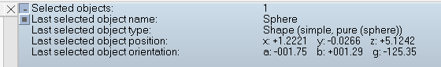
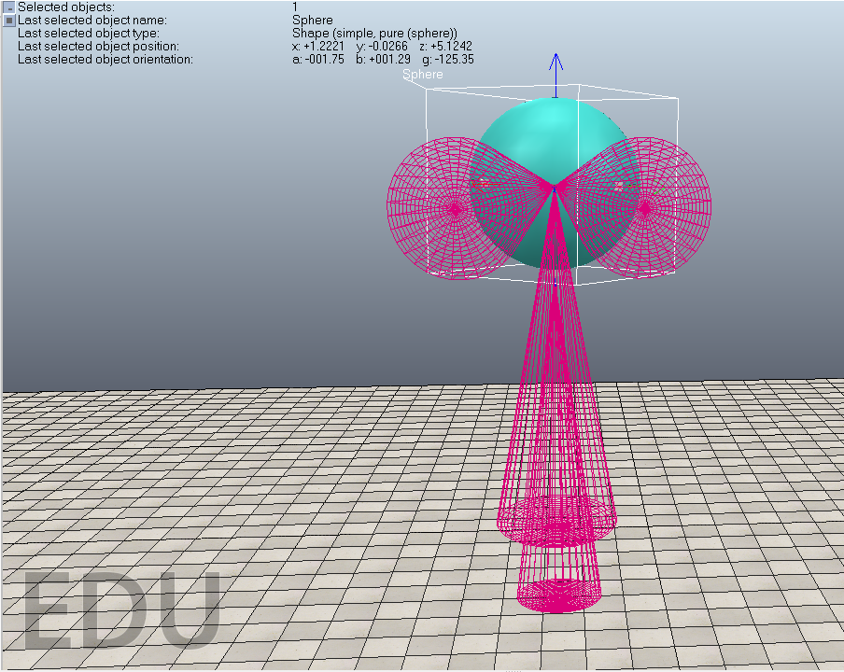
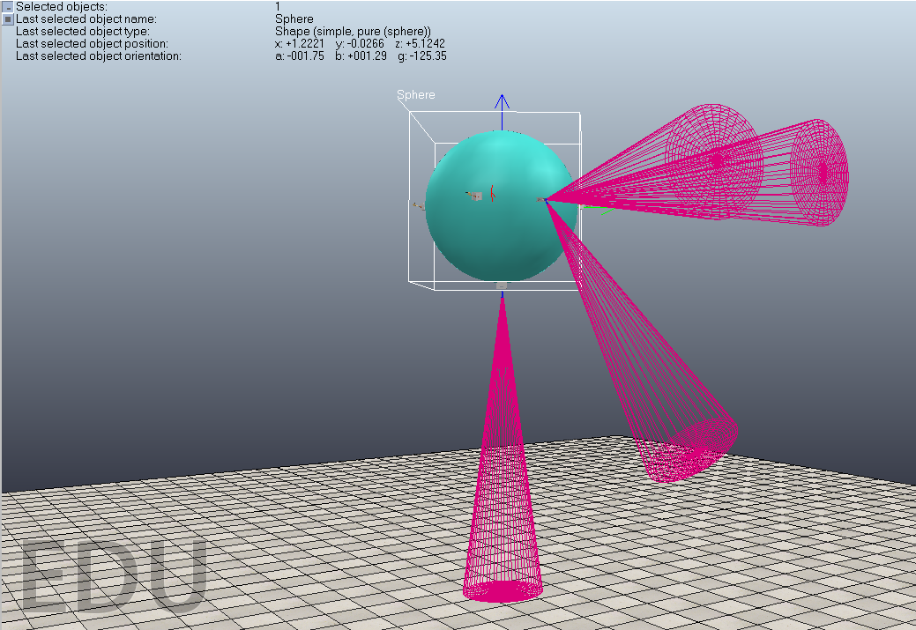
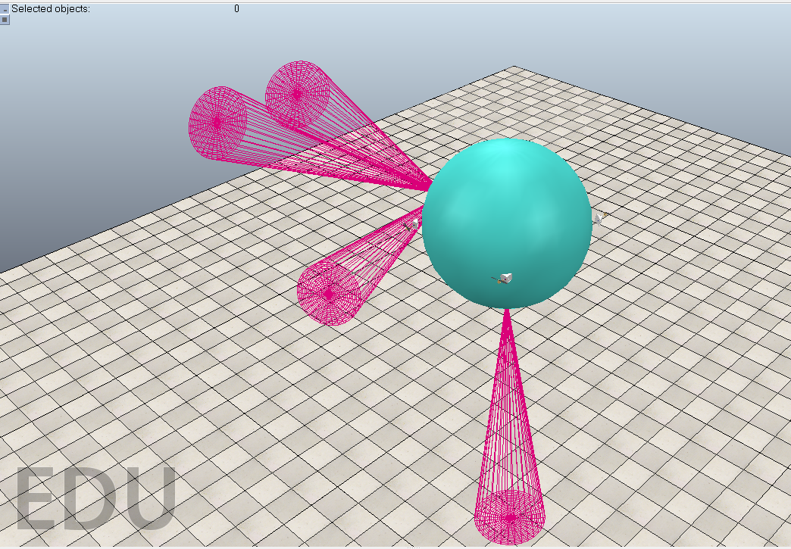
Ideal Sensors were Simulated in V-rep
Complete
Requirement: V-rep simulates sensor data for IMU, GPS, barometer, and ultrasonics.
GPS is represented by the x, y coordinates, barometer by the z coordinate, and IMU by the orientation of the drone in Euler angles, alpha, beta, gamma.
All four Ultrasonic sensors are displayed. Three of them are on the balloon facing forward and one is on the bottom. Ultrasonics display 4m ahead and identify the distance to the closest objects ahead of them.
Conclusion: V-rep simulation now provides data that imitates IMU, barometer, GPS, and ultrasonic, providing input to an in-progress autopilot controls system.

Slide 35

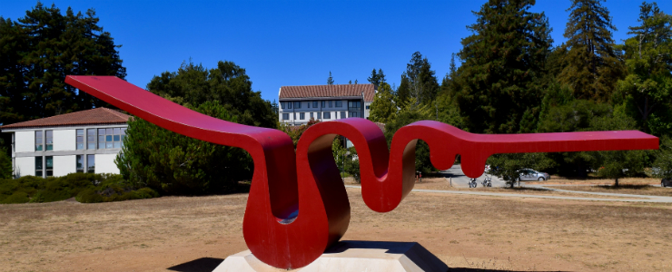
$500 of Funding Received
We entered the pitch competition on Baskin Day, won first, and earned $200 towards the project.
We requested and were approved for $300 from Crown.
We requested and are waiting on a response from Porter College on a $500 funding request.

Slide 36
End

